Slide 1
Meal Replacement Food and Drink
June 2011

Slide 2
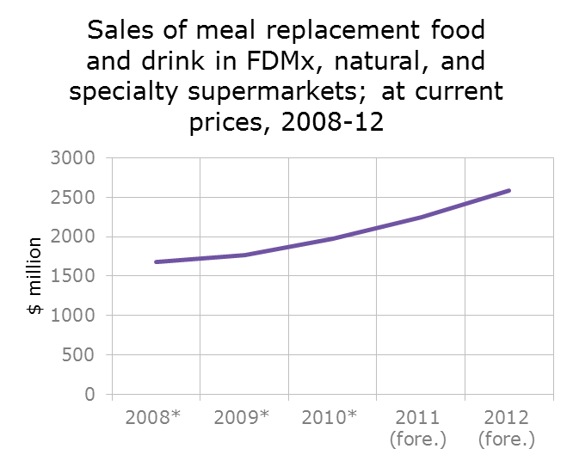
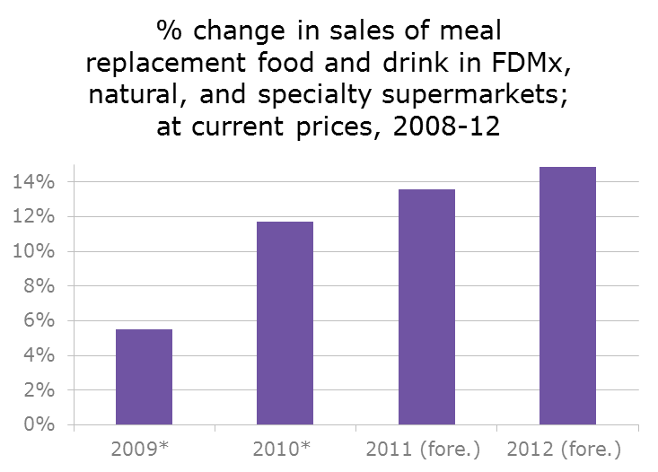

Meal replacement sector continues growth in 2010-11
U.S. dollar sales of meal replacement food and drink reached $2.3 billion in 2010-11—an 18% increase in sales during the three-year period of 2009-11.
This increase can be attributed not only to natural growth in a relatively immature category, but also the fact that consumers continue to look for meal solutions such as these to support their time-crunched lives. In addition, consumers also continue to have a focus on health, wellness, and dieting, and many of the products currently on the market in this category speak to at least one, if not all, of these issues.
* 52 weeks ending March 21, 2009; March 20, 2010; and March 19, 2011
Source: Mintel/SPINS/Nielsen
Notes:
The meal replacement food and drink market has been fuelled by growth across the board in the three primary segments: RTD meal replacements, energy bars, and powdered drink meal replacements. This suggests the extent to which harried consumers continue to look for solutions to a number of issues currently constraining their lives: increasingly hectic work days, health and wellness concerns, and aging, which often results in the desire for energy-increasing solutions.
Mintel’s Nutrition and Energy Bars—U.S., February 2011 report notes the rising demand for better-for-you snacks, though it also suggests that the market may be becoming saturated and will be impacted by the market reaching maturity. However, overall, not only will aging Baby Boomers continue to be actively seeking out products that will help them maintain an active lifestyle, but the number of people dieting is unlikely to slope downward.

Slide 3
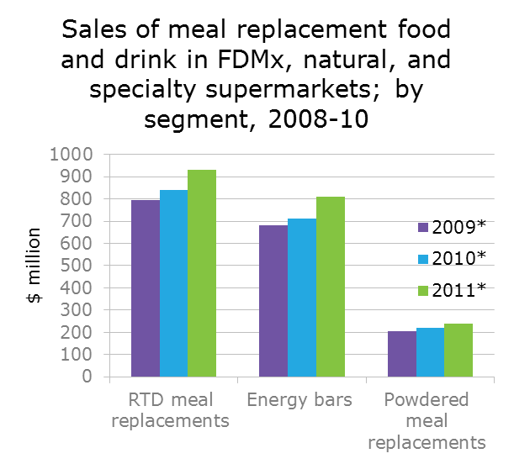
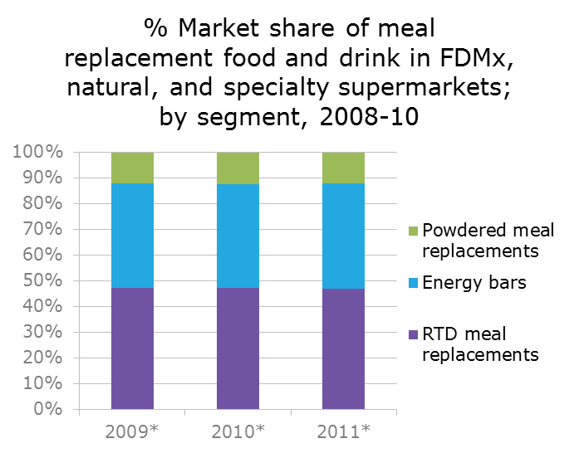
Sales increases across the board lead to market stability
The RTD meal replacement segment continues to hold steady in terms of market share, with few fluctuations overall between segments. In 2011, sales of RTD meal replacements represented 46.9% of total market share, for $930 million in sales at FDMx, natural, and specialty stores.
During 2009-11, the energy bars and powdered meal replacements segments remain in second and third place, respectively. The segments reached $811 million and $240 million in sales in 2011.
* 52 weeks ending March 21, 2009; March 20, 2010; and March 19, 2011
Source: Mintel/SPINS/Nielsen
Notes:
Because sales growth was similar in each segment within the meal replacement food and drink market, market share remained stable from 2009-11, with RTD meal replacements continuing in first place. All three segments experienced between 17-19% sales growth from 2009-11, certainly a healthy increase given economic woes in recent years. This is particularly significant as these types of products are generally sold at a premium, considered discretionary, and thus are not necessarily pegged as a necessity by many consumers. The continued sales growth, however, suggests that consumers why buy these products are not as price conscious in this particular market, as they may feel that meal replacement food and drink is necessary to their health and well-being, and/or weight-management goals.

Slide 4
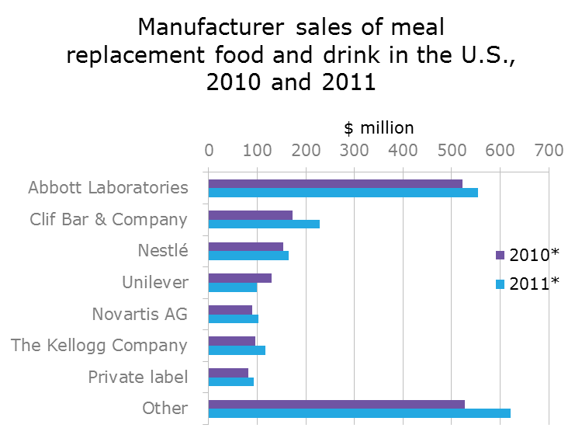
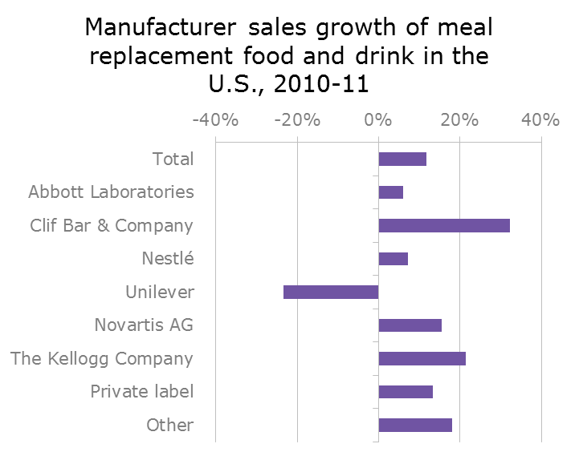
Abbott leads the market, while Clif leaps in growth
Abbott Laboratories continues to be the dominant player in the meal replacement food and drink market, with $555 million in sales in 2011 in FDMx, natural, and specialty stores (excluding Walmart, Trader Joe’s, and Whole Foods Market). This accounts for a 28% share of the market overall in 2011, a slight decrease from 29.5% in 2010.
Clif Bar & Company is second in this category, mainly due to its strong presence in the energy bar market. The company grew its sales more than 30% in the last year—by far the fastest growth of any company during the time period.
* 52 weeks ending March 20, 2010 and March 19, 2011
Source: Mintel/SPINS/Nielsen
Notes:
Abbott Laboratories has brands in all three segments within the meal replacement food and drink market, from Ensure and similar products in the RTD segment to Zone Perfect in energy bars and EAS in powdered drinks. These all target different demographic segments of the consumer market, and so Abbott is well-poised to continue to grow as it has diversified its portfolio sufficiently to withstand a downturn in any one segment of the market.
At the same time, Clif Bar & Company has shown impressive growth, as the company is a leading manufacturer of energy bars in the U.S. and tends to focus on new product development aimed at offering specific products to certain consumer segments (particularly women, kids, and athletes).
Nestlé is third overall, based on the strength of its Carnation Instant Breakfast drink, which remains a category leader in the powdered drink mix segment.

Slide 5
Market drivers at play
Continued focus on dieting: Consumers show no sign of reducing their dieting efforts, as 44% of those surveyed in Mintel’s custom consumer research indicate that they are currently dieting or have done so recently. Across age demographics, 18-44s over-index with regard to dieting (currently/recently), as well as indicating that they exercise regularly (6-7 days per week). These same age groups are more likely to use meal supplements, with 45% of the 18-24s, 52% of the 25-34s, and 37% of the 35-44s using meal supplements, respectively, compared to 36% on average.
Exercise/energy needs also fuel market: Millenials are a primary target for energy drink manufacturers and similar companies that have overlap into the meal replacement category, and they will continue to drive the market forward. Even the population of Generation Xers will continue to play a role as these are the most likely of any generation to participate in sports such as triathlons, and often utilize meal bars and RTD drinks and powders to fuel these types of activities.
The impact of household income: While salaries across America aren’t keeping up with the cost of living, the upward trend in real disposable income will likely have a positive impact on the meal replacement food and drink market. Furthermore, usage of meal supplements does increase as household income increases. Lastly, studies have shown that there are number of people who fall within the older and wealthy bracket and who are dubbed “Active Healthy Lifestyles” (AHLs) who focus on their workouts. For these consumers, meal replacement food and drink are attractive options.

Slide 6
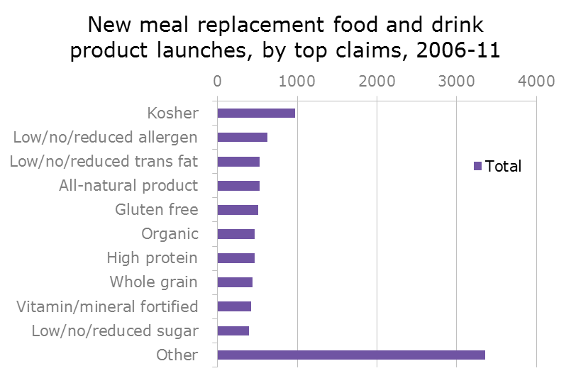
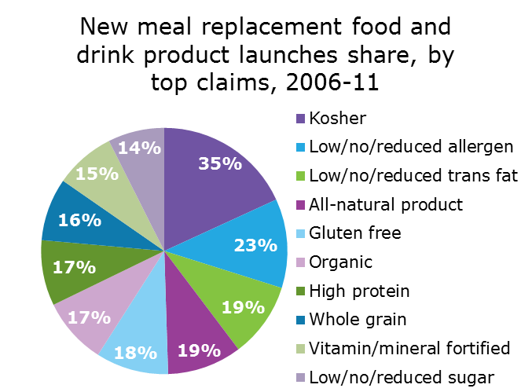
Innovators branch out with flavors/types
As monitored by Mintel’s Global New Products Database (GNPD), new product launches in snack/energy bars outpaced those of meal replacement drinks significantly from 2006-11.
Name brand new product launches outpace those of private label, indicating that perhaps consumers are looking for name brand items in this category and are finding them available at a wide range of price points. This is the case even as private label meal replacement food and drink products continue to sell well.
Note: share percentages don’t sum to 100 as products can have more than one claim
* Jan. 1-April 22, 2011
Source: Mintel’s GNPD
Notes:
Snack/cereal/energy bars are far and away the leaders in new product launches, with 2,327 from 2006-11, compared to just 455 for meal replacements and other drinks. Meal replacement products are limited in what they can offer consumers in terms of new formulations; to a certain extent they are limited to new flavors and additives, while energy bars manufacturers are more able to come up with new formats (such as chewy brownie bars or those that combine sweet and salty flavors with peanuts and pretzels, and similar options), as well as products targeted to lifestyles and activities (e.g., weight loss, athletics).
In spite of consumer desire for items with high protein, for example, most new launches fell under the kosher claim, suggesting that there may already simply be a vast number of products with a high-protein claim already on the market that consumers are simply not aware of. This should prompt these companies to focus their promotional efforts on educating shoppers as to what they can find on store shelves that will meet their specific needs and desires.
One company that has taken the idea that consumers are looking for something different and run with it is PROBAR, which is sold at stores such as Whole Foods and REI (as well as at other retailers), and bills itself as ““The Whole Food Meal Replacement, Organic, 100% Vegan, Ideal for Endurance or Recovery.” Such lofty claims aside, the product has developed a following simply because it looks and tastes good, with flavors in the Sweet & Savory line such as Cocoa Pistachio, Maple Pecan, and Cherry Pretzel. These types of flavors tap into consumers’ desires, as noted in the New Innovations of Interest to Consumers section, for items that fall more into the savory or sweet-salty categories.
Following suit with another new savory/sweet meal bar, The GardenChef Paul Company, which began business in 2008, has launched its gardenbar, which it markets as an “entrée in your pocket.” The product line, which was created by the founder of the highly successful Gardenburger brand of meat alternatives, includes ethnically-infused products like American Savory, Mexican Savory, Indian Savory, Italian Savory, and Japanese Savory.

Slide 7
Meal supplement* usage (1)
Roughly a third (36%) of adults personally use meal supplements of some kind (bars, drinks, or powders).
Bars are the most popular option, as 24% of adults personally use meal or snack bar supplements, however this is a far lower percentage than the two thirds (66%) who use vitamins or minerals. There may be room to target these health-conscious individuals to purchase more meal or snack bar supplements, positioning those supplements as a way to take in balanced nutrition even while on-the-go.
25-34s are more likely than other age groups to use meal or snack bar supplements such as Slim-Fast or Ensure, though 18-24s tend toward using all-purpose snack bars.
Respondents aged 65+ are most likely to use vitamin/mineral supplements, while those making over $75K tend to use more supplements overall.
Notes:
* Please note: Throughout the consumer sections, consumer respondents were asked about their use of “meal supplements” rather than “meal replacements.” This terminology was used in order to widen the opportunity for respondents to indicate that they use these types of products not just in place of meals, but also as part of dieting and/or athletic programs.

Slide 8
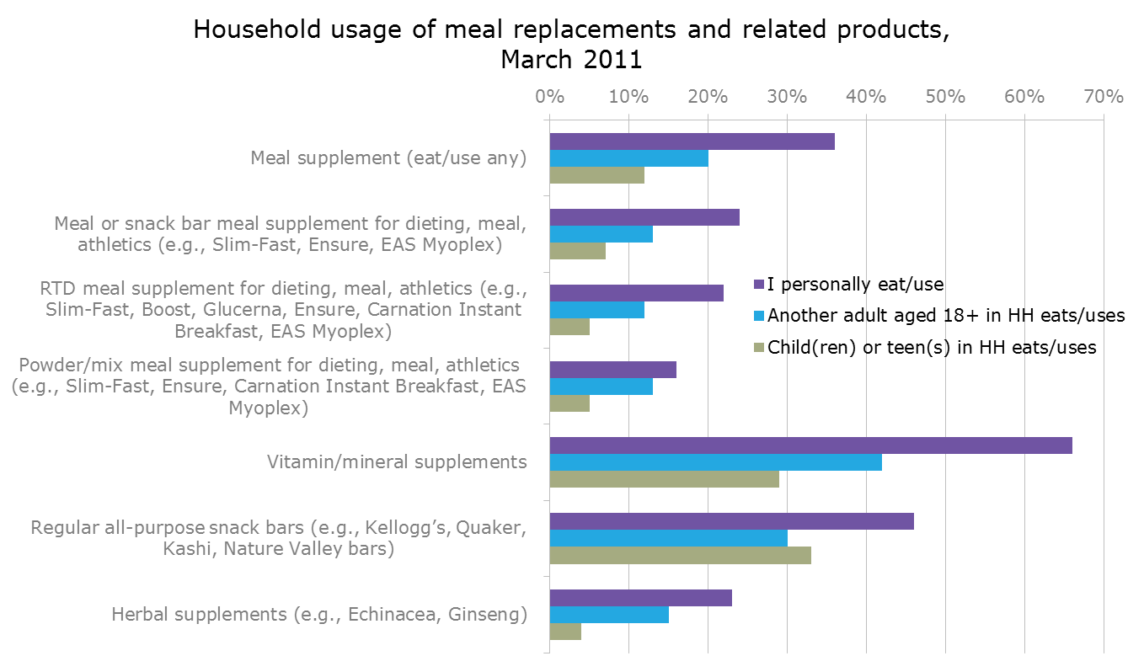
Meal supplement* usage (2)
Base: 2,000 adults 18+ with internet access
Base: 1,663 adults 18+ with internet access with another adult in HH
Base: 980 adults 18+ with internet access with child(ren) under 18 living in HH
Source: Mintel
Notes:
* Please note: Throughout the consumer sections, consumer respondents were asked about their use of “meal supplements” rather than “meal replacements.” This terminology was used in order to widen the opportunity for respondents to indicate that they use these types of products not just in place of meals, but also as part of dieting and/or athletic programs.

Slide 9
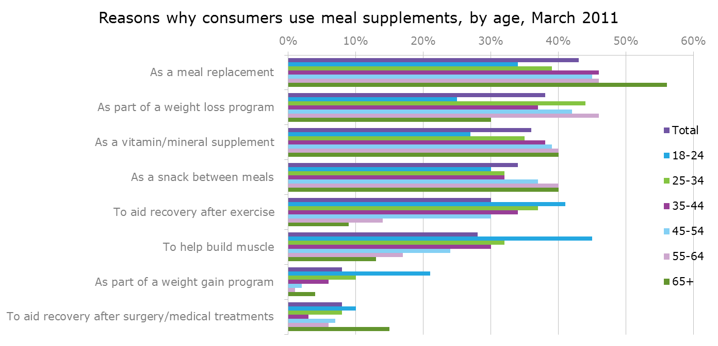
Usage drivers and deterrents
Over-35s (and especially seniors) over-index in usage of these products specifically as meal replacements. In part this may be due to reduced activity, which makes it harder to maintain weight without some sort of dieting program.
Over-35s use meal supplements to ensure proper nutrition, while 18-24s gravitate toward them for weight loss or gain, or to build muscle after exercising.
Base: 728 adults 18+ with internet access who use meal supplements
Source: Mintel
Notes:
As respondents age, they are more likely to use meal supplements as a meal replacement. Products such as Ensure are often targeted at an aging yet still active population, recognizing that eating enough of or the right kinds of foods to ensure proper nutrition can be difficult, and so often additional supplementation is needed. Either a loss of appetite, problems with teeth or dentures, or other issues may factor in, thus making this a good population to target. Those aged 18-24 are more likely than other age groups to indicate that they use meal supplements to aid recovery after exercise or to help build muscle or gain weight. These are factors typically indicative of usage by males, who are more likely to engage in these activities, or are more interested in gaining weight than are females. This age group may slightly over-index in males, but another factor may be that this age group is often comparatively very active, and regardless of gender may be looking for quick fixes to keep them happily on the go.

Slide 10
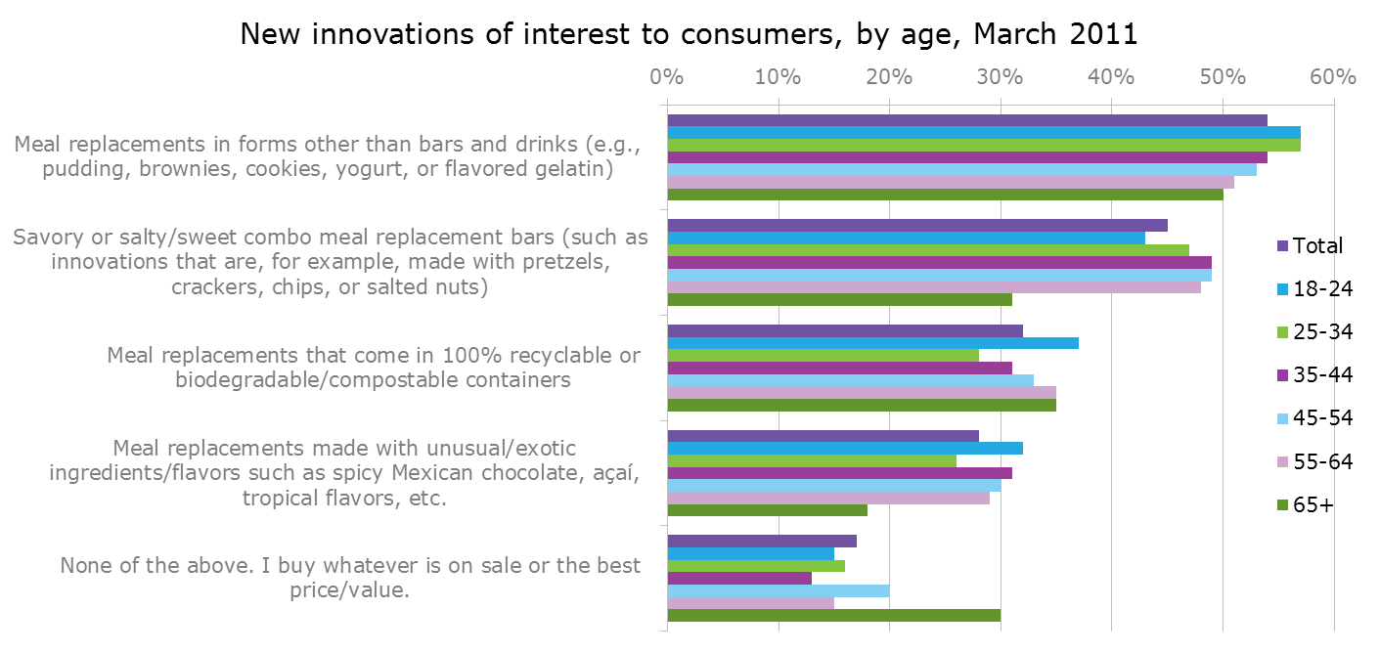
New Innovations of Interest to Consumers
Respondents who use meal supplements are looking for a wider range of product types, flavors, and formulations, with a full 17% showing little brand loyalty in that they will purchase simply what is on sale, looking for the greatest product value.
The youngest respondents (18-24s) tend to be interested in the most options, such as biodegradable packaging or unusual flavors or ingredients such as açaí berry.
Base: 728 adults 18+ with internet access who use meal supplements
Source: Mintel
Notes:
The youngest respondents, or those aged 18-34, are most likely to want a range of other options available to them with regard to meal replacements in other forms, with 57% indicating this to be the case. The 18-24s are also more interested in meal replacements that are in recyclable or biodegradable containers, or those that have unusual or exotic ingredients such as açaí or spicy Mexican chocolate. These youngest of respondents have grown up with the familiarity of a wide variety of flavors and ingredients commonplace on store shelves, and so as burgeoning adults, tend to seek out this same range of flavors, not content with the basic vanilla or chocolate that many meal replacement food or drink items are available in.

Slide 11
David Browne
Senior Analyst
tel: 312 932 0400
email: dbrowne@mintel.com

